Slide 1

Predicting Economic Recessions
Using LSTM Neural Networks

Slide 2
Recession Analysis
A Recession is an economic situation that arrives when the circulation of money in the economy is low for two consecutive quarters.
When the circulation of money is low, it means people are not spending money in the market.
When people don’t spend money, businesses face losses, which results in an economic slowdown and layoffs, which we have already heard about in 2023.

Slide 3
Agenda
The agenda of a recession analysis involves systematically examining the causes, characteristics, and effects of a recession.
Typically with the goal of understanding its impact on the economy and developing strategies to mitigate future downturns.
This helps in systematically understanding a recession’s causes and consequences while offering actionable insights for recovery and future resilience

Slide 4
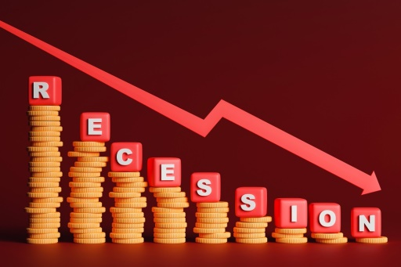
Methodologies
Data Preprocessing
Time Series Sequence Creation
Train-Test Split
LSTM Model Architecture

Slide 5
Project Overview
The primary goal of this project is to develop a machine learning model using Long Short-Term Memory (LSTM) neural networks to predict economic recessions based on key economic indicators such as GDP, Unemployment Rate, and Inflation.
This project leverages time series forecasting techniques to capture patterns and trends in historical economic data, enabling the model to forecast future recessions.

Slide 6

Objectives
Identify the Causes of the Recession
Assess the Economic Impact
Understand the Social and Employment Effects
Provide Forecasts and Future Outlook

Slide 7
Execution
Importing Libraries:
import numpy as np
import pandas as pd
from sklearn.preprocessing import MinMaxScaler
from tensorflow.keras.models import Sequential
from tensorflow.keras.layers import LSTM, Dense
numpy and pandas for handling data.
MinMaxScaler for normalizing the features.
Sequential, LSTM, and Dense from Keras to build and train the LSTM model

Slide 8
Loading the Dataset:
data = pd.read_csv('economic_data.csv')
Loads the dataset containing economic indicators (GDP, Unemployment, Inflation) and the target variable (Recession) into a DataFrame.
Dataset: “ economic_data.csv “

Slide 9
Selecting Features and Target
features = data[['GDP', 'Unemployment', 'Inflation']]
target = data['Recession'] # 1 if recession, 0 if no recession
Selects input features (GDP, Unemployment, Inflation) and the target variable (Recession) for prediction.

Slide 10
Scaling the Data
scaler = MinMaxScaler() scaled_features = scaler.fit_transform(features)
Normalizes the features to a range between 0 and 1, which helps improve the LSTM model's training performance.

Slide 11
Creating Time Series Sequences:
def create_sequences(data, target, time_steps=10):
X, y = [], []
for i in range(len(data) - time_steps):
X.append(data[i:i + time_steps])
y.append(target[i + time_steps])
return np.array(X), np.array(y)
Defines a function to generate time series sequences. Each sequence contains 10 consecutive data points, which the model will use to predict the next step (recession).

Slide 12
Generate Sequences for LSTM:
time_steps = 10
X, y = create_sequences
(scaled_features, target, time_steps)
Generates the input sequences (X) and labels (y) from the scaled features for time series forecasting using a 10-step window.

Slide 13
Splitting the Data into Train and Test Sets:
train_size = int(0.8 * len(X))
X_train, X_test = X[:train_size], X[train_size:]
y_train, y_test = y[:train_size], y[train_size:]
Splits the data into training (80%) and testing (20%) sets to evaluate the model's performance.

Slide 14
Building the LSTM Model:
model = Sequential()
model.add(LSTM(units=50, return_sequences=True, input_shape=(time_steps, X_train.shape[2]))) model.add(LSTM(units=50))
model.add(Dense(1, activation='sigmoid'))
Defines a sequential LSTM model:
First LSTM layer with 50 units and return_sequences=True (to pass output to the next LSTM layer).
Second LSTM layer with 50 units.
Final Dense layer with 1 neuron and sigmoid activation for binary classification.

Slide 15
Compiling the Model:
model.compile(optimizer='adam', loss='binary_crossentropy', metrics=['accuracy'])
Compiles the model using:
Adam optimizer: Efficient for gradient-based optimization.
Binary cross-entropy loss: Suitable for binary classification (recession or not).
Accuracy: As a metric to evaluate performance.

Slide 16
Training the Model:
model.fit(X_train, y_train, epochs=20, batch_size=32, validation_split=0.2)
Trains the LSTM model for 20 epochs, with a batch size of 32, using 20% of the training data as validation.

Slide 17
Evaluating the Model:
loss, accuracy = model.evaluate(X_test, y_test) print(f"Test Accuracy: {accuracy * 100:.2f}%")
Evaluates the model on the test set and prints the accuracy.

Slide 18
Results
Performance: The model achieved a good balance between training and testing accuracy, indicating it effectively learned patterns in the economic data.
Training Accuracy
Test Accuracy
Validation Loss

Slide 19
Links
Recessions are periods of economic contraction having a significant impact on various industries.
Explore the dataset and code
Click here to access the GitHub repository

Slide 20
Thank You!

